Slide 1
Advanced Web Design Using HTML, CSS, and Bootstrap
Instructor Name: Nshimiyimana Christophe
Location : On-Site, Makuza Peace Plaza
Duration: 8 weeks
Introduction to Advanced Web Design
Website : www.tsindamedia.com
Tel : +250 798 873 226

Slide 2
Course Overview
Objective: Equip students with advanced web design techniques, including responsive layouts, advanced styling, and efficient use of Bootstrap.
Key Topics:
1.HTML5 Semantic Elements
2. Advanced CSS Layouts (Flexbox, Grid)
3. Bootstrap Framework
4. Responsive Design Best Practices
5. Real-world Project: Build a Responsive Website

Slide 3
Why Learn Advanced Web? Design?
Importance:
User Experience (UX) and User Interface (UI) are crucial for web success.
High demand for skilled frontend developers.
Career Opportunities:
Web Developer
UI/UX Designer
Frontend Engineer

Slide 4
Module 1: Advanced HTML5 Techniques
HTML5 Overview
What is HTML5?:
Latest version of HTML, offering semantic tags, multimedia support, and improved performance.
Why Use Semantic Elements?:
Improves accessibility and SEO.
Enhances the structure and readability of the code.
Common Semantic Elements:
<header>, <nav>, <article>, <section>, <footer>

Slide 5
Semantic Markup in Action
<header>
<h1>Welcome to My Portfolio</h1>
<nav>
<ul>
<li><a href="#about">About</a></li>
<li><a href="#projects">Projects</a></li>
</ul>
</nav>
</header>
<section id="about">
<h2>About Me</h2>
<p>I am a web developer...</p>
</section>
<footer>© 2024 My Portfolio</footer>

Slide 6
Hands-On Practice: Using
Semantic HTML
Task: Update an existing webpage using HTML5 semantic tags to improve structure and accessibility.

Slide 7
Module 2: Advanced CSS Layout Techniques
CSS Flexbox Overview
What is Flexbox?:
A CSS layout model for aligning and distributing items in a container.
Why Use Flexbox?:
Efficient for creating flexible, responsive layouts.
Key Properties:
display: flex;
justify-content, align-items
flex-direction, flex-wrap

Slide 8
Building a Layout with Flexbox
.container {
display: flex;
justify-content: space-between;
align-items: center;
}
.item {
flex: 1;
margin: 10px;
}

Slide 9
CSS Grid Layout Overview
What is CSS Grid?:
A powerful two-dimensional layout system in CSS.
Why Use CSS Grid?:
Best for building complex layouts like page grids and form structures.
Key Properties:
display: grid;
grid-template-columns, grid-template-rows
grid-gap, grid-area

Slide 10
y.
Building a Layout with CSS Grid
.grid-container {
display: grid;
grid-template-columns: repeat(3, 1fr);
grid-gap: 20px;
}
.grid-item {
padding: 20px;
background-color: lightblue;
}

Slide 11
Hands-On Practice:
Flexbox and Grid
Task: Use both Flexbox and Grid to create a responsive layout for a portfolio website.

Slide 12
Module 3: Introduction to Bootstrap Framework
What is Bootstrap?
Definition: Bootstrap is a popular front-end framework for building
responsive websites with prebuilt CSS and JavaScript components.
Why Use Bootstrap?:
Speeds up development with pre-designed UI elements.
Mobile-first approach ensures responsiveness across devices.

Slide 13
OUTPUT DEVICES
Setting Up Bootstrap
CDN Integration:
It is any piece of computer hardware that receives data from one source and converts it into another form.
<link rel="stylesheet" href="https://stackpath.bootstrapcdn.com/bootstrap/4.5.2/css/bootstrap.min.css">
<script src="https://code.jquery.com/jquery-3.5.1.slim.min.js"></script>
<script src="https://cdn.jsdelivr.net/npm/bootstrap@4.5.2/dist/js/bootstrap.bundle.min.js"></script>
It is also a computer equipment that convert information into a human-perceptible form.

Slide 14
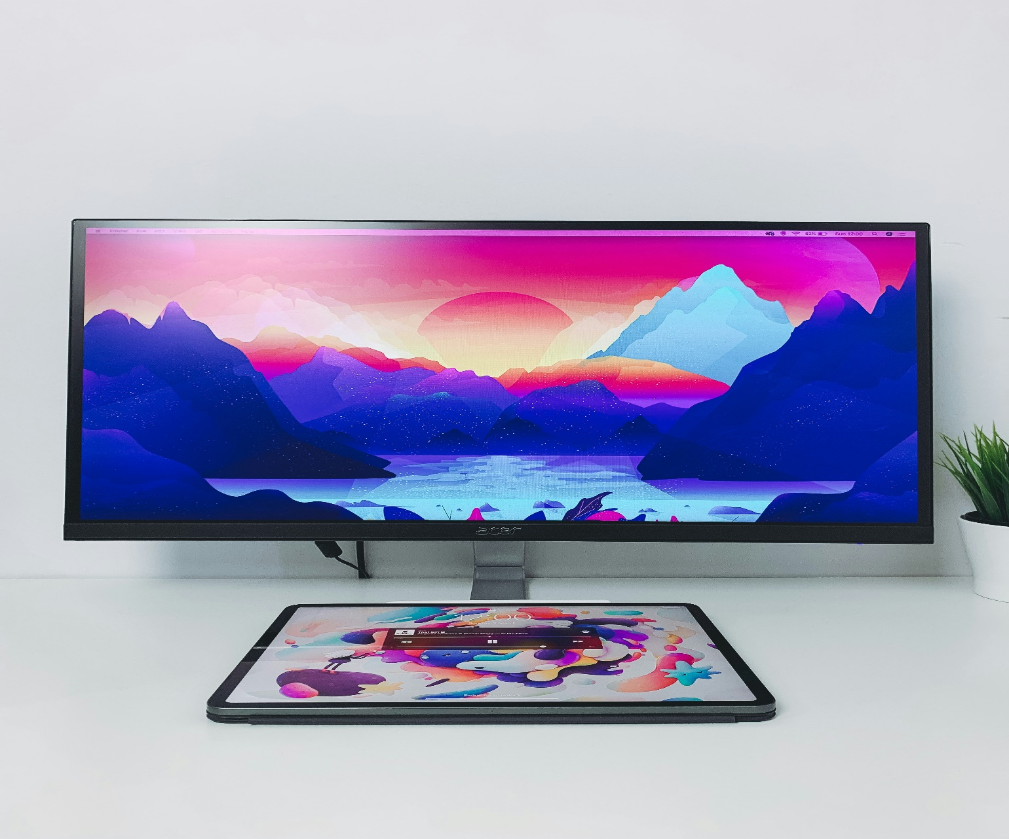
Bootstrap Grid System
Monitor
OUTPUT DEVICES
Monitor, or display, is an output device that shows visual information generated by a computer.
It is any piece of computer hardware that receives data from one source and converts it into another form.
What is the Bootstrap Grid System?:
A flexible layout system based on a 12-column grid.
Key Features:
Responsive layouts using classes like .col-md-6, .col-lg-4
Automatically adjusts columns based on screen size.
It is also a computer equipment that convert information into a human-perceptible form.
It provides a visual interface for users to view applications, documents, videos, and more.

Slide 15
Bootstrap Grid Example
<div class="container">
<div class="row">
<div class="col-md-6">Column 1</div>
<div class="col-md-6">Column 2</div>
</div>
</div>

Slide 16
Hands-On Practice: Bootstrap Grid
Task: Build a responsive two-column layout using Bootstrap’s grid system.

Slide 17
Module 4: Bootstrap Components
Introduction to Bootstrap Components
Popular Components:
Navbar: <nav>
Buttons: <button class="btn btn-primary">
Cards: <div class="card">
Modals: <div class="modal">
Why Use Them?:
Prebuilt, customizable UI components for faster development.

Slide 18
Using Bootstrap Cards
<div class="card" style="width: 18rem;">
<img src="..." class="card-img-top" alt="...">
<div class="card-body">
<h5 class="card-title">Card Title</h5>
<p class="card-text">Some quick example text to build on the card title.</p>
<a href="#" class="btn btn-primary">Go somewhere</a>
</div>
</div>

Slide 19
Hands-On Practice: Bootstrap Navbar and Cards
Task: Build a responsive webpage with a Bootstrap navbar and card components.

Slide 20
Module 5: Responsive
Design Best Practices
What is Responsive Design?
Definition: Responsive design ensures websites look good on all screen sizes, from phones to desktops.
Best Practices:
Use relative units like %, vw, vh, and em.
Implement media queries for different screen sizes.
Test layouts across various devices and browsers.

Slide 21
Media Queries in Action
@media (max-width: 768px) {
.container {
flex-direction: column;
}
}

Slide 22
Hands-On Practice: Building
a Responsive Website
Task: Add media queries to the project website to adjust layouts for mobile devices.

Slide 23
Final Project: Building a Responsive Website
Project Overview
Objective: Apply everything learned in the course to build a responsive,
modern website using HTML, CSS, and Bootstrap.
Components:
1.Use semantic HTML5 for structure.
2. Implement Flexbox and Grid for layout.
3. Use Bootstrap for UI components and responsiveness.
4. Add media queries for mobile optimization.

Slide 24
Thank you for being part of this journey! With your advanced web design expertise, you're now prepared to craft modern, responsive, and engaging websites. The web is yours to shape!
Website : www.tsindamedia.com
Tel : +250 798 873 226

